Slide 1
Pop-Up Shop Analysis
Where to do a pop-up shop for women’s activity clothing store?

Slide 2
Purpose
Having a store front can add a lot of overhead and extra cost to running a business, particularly smaller businesses that have a very targeted clientele. It has become more common to see random pop-up stores at temporary locations. The operator of these shops have low overhead for facilities and have the flexibility to setup close to their clients. Store fronts for high end women’s athletic clothing (i.e. Lululemon and Athleta) are very scarce so it would be ideal to do a pop-up shop for these types of stores. The purpose of this analysis is to help identify ideal locations to help support a pop-up store, and a good place would be at a coffee shop (preferable locally owned) close to a yoga studio.

Slide 3
Audience
While this analysis was targeted for someone who wants to set-up a women’s athletic clothing pop-up shop near a Yoga studio, it could also benefit anyone that wants to correlate a Yoga studio with a coffee shop. This could also be used by someone who wanted to sell herbal supplements as a beverage to the coffee shop to help target healthy life styled individuals.

Slide 4
The Data
We first target venues in Iowa City so the first pieces of data the latitude and longitude coordinates for Iowa City
Latitude – 41.6611
Longitude – -91.5302
This was obtained from performing a Google Search.
The second piece of data is a list of all the Coffee Shops within a 10 KM radius of Iowa City.
This was obtained from using the Foursquare API using the venues search.
ShopsCategoryId = '4bf58dd8d48988d1e0931735‘
Key data elements used are Name, Latitude and Longitude.
30 Coffee Shops were returned.
The last piece of data is a list of all the Yoga Studios within a 10 KM radius of Iowa City.
This was obtained from using the Foursquare API using the venues search.
CategoryId = '4bf58dd8d48988d102941735‘
Key data elements used are Name, Latitude and Longitude.
8 Yoga Studios were returned.

Slide 5
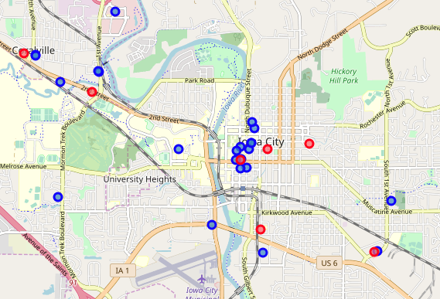
The Analysis
To get a geo-spatial representation of Yoga Studios to Coffee Shops, the venues were plotted on map using Folium. Coffee Shops were plotted in Blue, and Yoga Studios were plotted in Red.

Slide 6
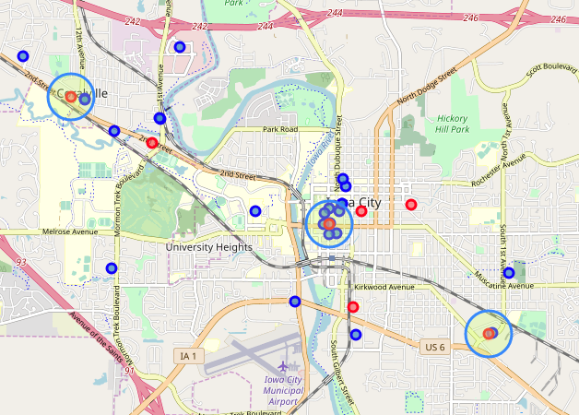
The Analysis - cont’d
From reviewing the prior plotted map, I’ve identified three Yoga Studios that are rather close to Coffee Shops.

Slide 7
The Results and Conclusion
Based on proximity, there are three Yoga Studios that would be good targets to set-up a pop-up shop at a near-by Coffee Shop.
High Ground Cafe near Hothouse Yoga in Coralville
Java House near Zenergi Hot Yoga in Iowa City
Fair Grounds Coffeehouse or The Encounter Cafe near Hothouse Yoga in Iowa City

